Slide 1
Diving into
C++ linker
Denis Bakhvalov
28-10-2015

Slide 2
What is linker for?
Compilation steps:
Preprocessing
Translation
Assembling
Linking

Slide 3
Preprocessing
Input:
Output:
// A.cpp
#define UNUSED_VAR(x) (void)x
void A()
{
int a;
UNUSED_VAR(a);
}
$ g++ -E -P A.cpp
void A()
{
int a;
(void)a;
}

Slide 4
Translation
Input:
Output:
$ g++ -Wall -S A.cpp
.text
.align 2
.globl _Z1Av
.type _Z1Av, @function
_Z1Av:
.LFB2:
pushq %rbp
.LCFI0:
movq %rsp, %rbp
.LCFI1:
movl $5678, -4(%rbp)
movl stat_var(%rip), %eax
movl %eax, -4(%rbp)
leave
ret
.LFE2:
.size _Z1Av, .-_Z1Av
// A.cpp
static int stat_var = 1234;
void A()
{
int local_var = 5678;
local_var = stat_var;
}
.data
.align 4
.type stat_var, @object
.size stat_var, 4
stat_var:
.long 1234

Slide 5
Assembling
Input:
Output:
// A.cpp
static int stat_var = 1234;
void A()
{
int local_var = 5678;
local_var = stat_var;
}
$ g++ -Wall –c A.cpp
$ nm -C -S A.o
0000000000000000 0000000000000016 T A()
U __gxx_personality_v0
0000000000000000 0000000000000004 d stat_var

Slide 6
Objdump tool
$ objdump -s A.o
Contents of section .text:
0000 554889e5 c745fc2e 1600008b 05000000 UH...E..........
0010 008945fc c9c3 ..E...
Contents of section .data:
0000 d2040000 ....
...
Contents of section .comment:
0000 00474343 3a202847 4e552920 342e312e .GCC: (GNU) 4.1.
0010 32203230 30383037 30342028 52656420 2 20080704 (Red
0020 48617420 342e312e 322d3438 2900 Hat 4.1.2-48).
Note: Full description can be found here https://sourceware.org/binutils/docs/binutils/objdump.html#objdump

Slide 7
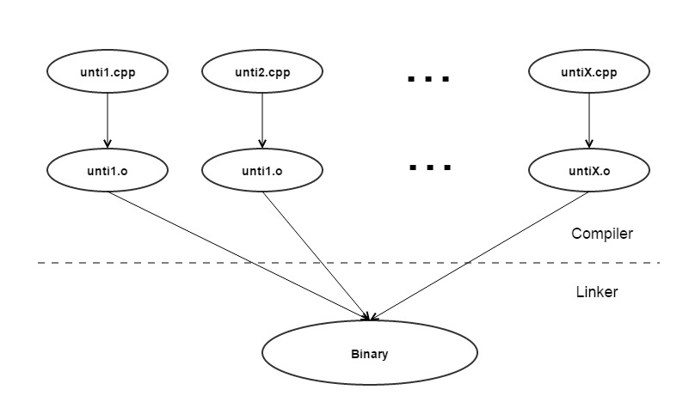
Compilation steps scheme

Slide 8
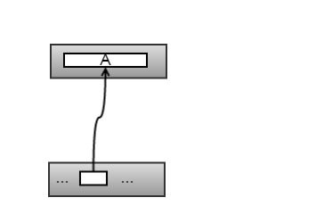
Linking
// A.cpp
void A()
{
}
// main.cpp
void A();
int main()
{
A();
}
// A.cpp
// main.cpp

Slide 9
Analysis using nm tool
Input:
Output:
// A.cpp
void A()
{
}
// main.cpp
void A();
int main()
{
A();
}
$ nm -C -S main.o
U A()
U __gxx_personality_v0
0000000000000000 0000000000000010 T main
$ nm -C -S A.o
0000000000000000 0000000000000006 T A()
U __gxx_personality_v0
$ nm -C -S executable
...
0000000000400528 0000000000000006 T A()
...
0000000000400530 0000000000000010 T main
...

Slide 10
One more example…
Input:
Output:
// A.cpp
static int statInt = 1234;
static double statDNotInit;
char globChar;
void A()
{
int localInt = 0;
}
$ nm -C -S A.o
0000000000000000 0000000000000021 T A()
U __gxx_personality_v0
0000000000000000 0000000000000001 B globChar
0000000000000008 0000000000000008 b statDNotInit
0000000000000000 0000000000000004 d statInt
Note: Full description can be found here https://sourceware.org/binutils/docs/binutils/nm.html

Slide 11
Rules without enforcement
// A.cpp
#include <stdio.h>
struct S
{
void foo()
{
printf("A.cpp\n");
}
};
void fooA()
{
S s;
s.foo();
}
// B.cpp
#include <stdio.h>
struct S
{
void foo()
{
printf(“B.cpp\n");
}
};
void fooB()
{
S s;
s.foo();
}
// main.cpp
void fooA();
void fooB();
int main()
{
fooA();
fooB();
}

Slide 12
Rules without enforcement
$ g++ -c -Wall -Werror –o A.o A.cpp
$ g++ -c -Wall -Werror –o B.o B.cpp
$ g++ -c -Wall -Werror -o main.o main.cpp
$ g++ -o simpleExample A.o B.o main.o
$ ./simpleExample
A.cpp
A.cpp
Note: Breaking one definition rule.
C++ $

Slide 13
Rules without enforcement
$ g++ -c -Wall -Werror –o A.o A.cpp
$ g++ -c -Wall -Werror –o B.o B.cpp
$ g++ -c -Wall -Werror -o main.o main.cpp
$ g++ -o simpleExample A.o B.o main.o
$ ./simpleExample
A.cpp
A.cpp
$ g++ -c -Wall -Werror –o A.o A.cpp
$ g++ -c -Wall -Werror –o B.o B.cpp
$ g++ -c -Wall -Werror -o main.o main.cpp
$ g++ -o simpleExample B.o A.o main.o
$ ./simpleExample

Slide 14
Rules without enforcement
$ g++ -c -Wall -Werror –o A.o A.cpp
$ g++ -c -Wall -Werror –o B.o B.cpp
$ g++ -c -Wall -Werror -o main.o main.cpp
$ g++ -o simpleExample A.o B.o main.o
$ ./simpleExample
A.cpp
A.cpp
$ g++ -c -Wall -Werror –o A.o A.cpp
$ g++ -c -Wall -Werror –o B.o B.cpp
$ g++ -c -Wall -Werror -o main.o main.cpp
$ g++ -o simpleExample B.o A.o main.o
$ ./simpleExample
B.cpp
B.cpp

Slide 15
Rules without enforcement
$ objdump -d simpleExample
...
0000000000400578 <_Z4fooAv>:
400578: 55 push %rbp
400579: 48 89 e5 mov %rsp,%rbp
40057c: 48 83 ec 10 sub $0x10,%rsp
400580: 48 8d 7d ff lea 0xffffffffffffffff(%rbp),%rdi
400584: e8 2b 00 00 00 callq 4005b4 <_ZN1S3fooEv>
400589: c9 leaveq
40058a: c3 retq
40058b: 90 nop
...
00000000004005e4 <_Z4fooBv>:
4005e4: 55 push %rbp
4005e5: 48 89 e5 mov %rsp,%rbp
4005e8: 48 83 ec 10 sub $0x10,%rsp
4005ec: 48 8d 7d ff lea 0xffffffffffffffff(%rbp),%rdi
4005f0: e8 bf ff ff ff callq 4005b4 <_ZN1S3fooEv>
4005f5: c9 leaveq
4005f6: c3 retq
4005f7: 90 nop
...

Slide 16
Rules without enforcement
$ objdump -d simpleExample
...
00000000004005b4 <_ZN1S3fooEv>:
4005b4: 55 push %rbp
4005b5: 48 89 e5 mov %rsp,%rbp
4005b8: 48 83 ec 10 sub $0x10,%rsp
4005bc: 48 89 7d f8 mov %rdi,0xfffffffffffffff8(%rbp)
4005c0: bf 08 07 40 00 mov $0x400708,%edi
4005c5: e8 9e fe ff ff callq 400468 <puts@plt>
4005ca: c9 leaveq
4005cb: c3 retq
...
$ objdump -s simpleExample
...
Contents of section .rodata:
4006f8 01000200 00000000 00000000 00000000 ................
400708 412e6370 7000422e 63707000 A.cpp.B.cpp.
...
Note: If we revert the order of linking object files than we will see “B.cpp.A.cpp.”

Slide 17
Rules without enforcement
According to C++ standard (ISO/IEC N4527):
§3.2 One definition rule
...
(6)There can be more than one definition of a class type (…) with external linkage. … Given such an entity named D defined in more than one translation unit, then:
- (6.1) — each definition of D shall consist of the same sequence of tokens;
...
If the definitions of D satisfy all these requirements, then the behavior is as if there were a single definition of D. If the definitions of D do not satisfy these requirements, then the behavior is undefined.
Link: http://open-std.org/JTC1/SC22/WG21/docs/papers/2015/n4527.pdf

Slide 18
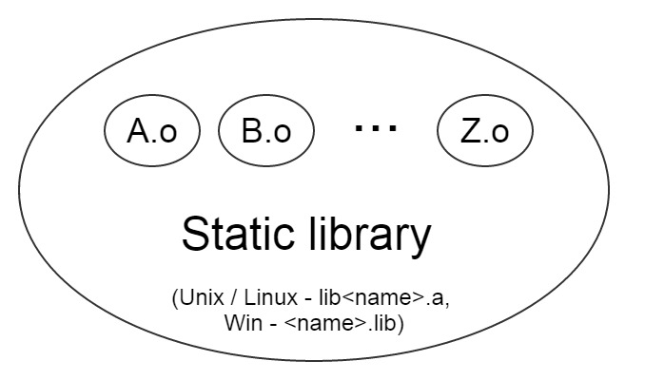
Static libraries
Note: Static library is just a collection(archive) of object files.

Slide 19
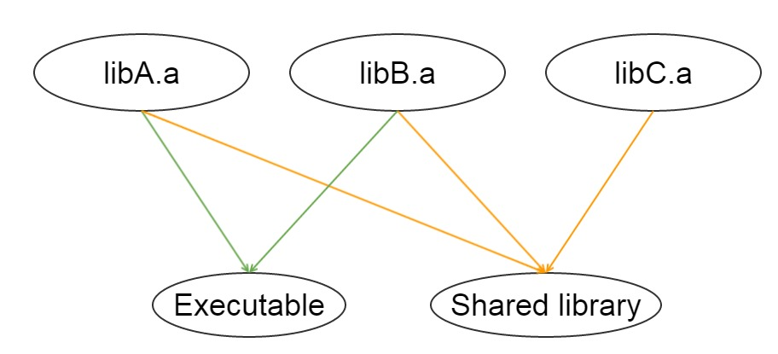
Static libraries
Note: Static library are used like a building blocks for other components

Slide 20
Do linker throws away unused code?
// Counter.h
#pragma once
struct Counter
{
Counter();
static unsigned int count;
};
// Counter.cpp
#include "Counter.h"
unsigned int Counter::count = 0;
Counter::Counter()
{
++count;
}

Slide 21
Do linker throws away unused code?
// A.cpp
#include "Counter.h"
static Counter A;
// B.cpp
#include "Counter.h"
static Counter B;
// main.cpp
#include "Counter.h"
#include <iostream>
int main()
{
std::cout << Counter::count;
}

Slide 22
Do linker throws away unused code?
$ g++ -c -Wall -Werror –o A.o A.cpp
$ g++ -c -Wall -Werror -o B.o B.cpp
$ g++ -c -Wall -Werror –o Counter.o Counter.cpp
$ g++ -c -Wall -Werror –o main.o main.cpp
$ g++ -o simpleExample A.o B.o Counter.o main.o
$ ./simpleExample
2

Slide 23
Do linker throws away unused code?
Now we will ship A.o, B.o and Counter.o as a static library:
$ g++ -c -Wall -Werror –o A.o A.cpp
$ g++ -c -Wall -Werror –o B.o B.cpp
$ g++ -c -Wall -Werror –o Counter.o Counter.cpp
$ ar rcs libStaticlib.a A.o B.o Counter.o
$ g++ -o simpleExample main.cpp -L./ -lStaticlib
$ ./simpleExample
0

Slide 24
Do linker throws away unused code?
A.o, B.o and Counter.o are included in static library.
Explicitly add A.o for the linker.
$ g++ -c -Wall -Werror –o A.o A.cpp
$ g++ -c -Wall -Werror –o B.o B.cpp
$ g++ -c -Wall -Werror –o Counter.o Counter.cpp
$ ar rcs libStaticlib.a A.o B.o Counter.o
$ g++ -o simpleExample main.cpp -L./ -lStaticlib A.o
$ ./simpleExample
1

Slide 25
Do linker throws away unused code?
A.o, B.o and main.o are included in static library.
Forcing linker to include all object files from static library.
$ g++ -c -Wall -Werror –o A.o A.cpp
$ g++ -c -Wall -Werror –o B.o B.cpp
$ g++ -c -Wall -Werror –o Counter.o Counter.cpp
$ ar rcs libStaticlib.a A.o B.o Counter.o
$ g++ -o simpleExample main.cpp -L./ -Wl,--whole-archive -lStaticlib -Wl,-no-whole-archive
$ ./simpleExample
2
Note: be careful with that option.

Slide 26
End of part1.
“Diving into C++ linker”
Denis Bakhvalov
29-07-2015

Slide 27
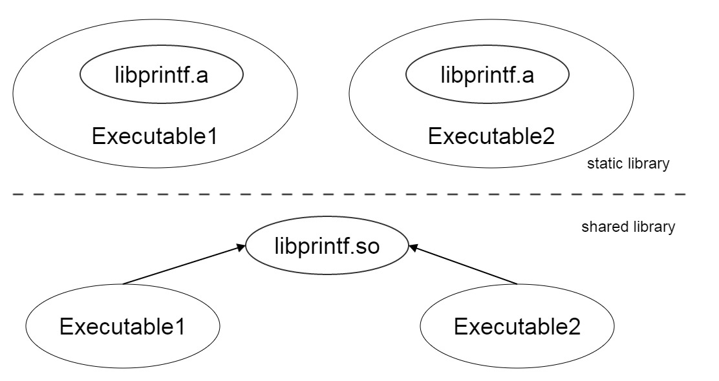
Shared libraries
Advantages of shared libraries:
Memory savings
Modularity
Dynamic linking.

Slide 28
Export from shared library
On Linux all symbols are exported automatically.
To hide some symbol you can:
- -fvisibility compiler flag
- __attribute__ ((visibility("<default | hidden>")))
- #pragma visibility [push | pop]
On Win there are several ways to export symbols. We will use __declspec(dllexport):
- __declspec(dllexport) int my_exported_function(int x, double y);
- *.def files

Slide 29
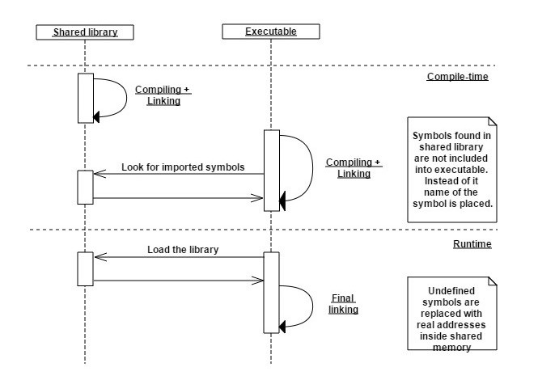
Static linking of dynamic libraries

Slide 30
Static linking of dynamic libraries
// main_DLL.cpp
#include <iostream>
void main_DLL()
{
std::cout << "Hello from main_Dll()" << std::endl;
}
// main.cpp
void main_DLL();
int main()
{
main_DLL();
}

Slide 31
Static linking of dynamic libraries
$ g++ -c -Wall -Werror -fPIC –o main_DLL.o main_DLL.cpp
$ g++ -shared -fPIC -o libsharedLib.so main_DLL.o
$ g++ -fPIC -o simpleExample main.cpp -lsharedLib
$ LD_LIBRARY_PATH = <path to sharedLib>
$ export LD_LIBRARY_PATH
$ ./simpleExample
Hello from main_Dll()
Notes:
On Linux there is no difference from static library linking.

Slide 32
Static linking of dynamic libraries
$ ldd simpleExample
linux-vdso.so.1 => (0x00007fff38bff000)
libsharedLib.so => <path to sharedLib>/libsharedLib.so (0x00007f08e3500000)
libstdc++.so.6 => /usr/lib64/libstdc++.so.6 (0x0000003c98600000)
libm.so.6 => /lib64/libm.so.6 (0x0000003c94a00000)
libgcc_s.so.1 => /lib64/libgcc_s.so.1 (0x0000003c97e00000)
libc.so.6 => /lib64/libc.so.6 (0x0000003c94200000)
/lib64/ld-linux-x86-64.so.2 (0x0000003c93200000)
If you see such error:
./simpleExample: error while loading shared libraries: libsharedLib.so:
cannot open shared object file: No such file or directory
First you need to do is to check your LD_LIBRARY_PATH variable.

Slide 33
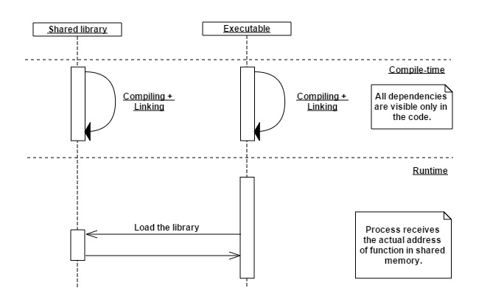
Dynamic linking of dynamic libraries

Slide 34
Dynamic linking of dynamic libraries
// main_DLL.cpp
#include <iostream>
extern "C"
{
void main_DLL()
{
std::cout << "Hello from main_Dll()" << std::endl;
}
}

Slide 35
Dynamic linking of dynamic libraries
// main.cpp
#include "dlfcn.h"
typedef void (*funPtr)(void);
int main()
{
void *handle = dlopen ("libsharedLib.so", RTLD_LAZY);
funPtr fun = (funPtr)dlsym (handle, "main_DLL");
(*fun)();
dlclose(handle);
}

Slide 36
Dynamic linking of dynamic libraries
g++ -c -Wall -Werror -fPIC –o main_DLL.o main_DLL.cpp
g++ -shared -fPIC -o libsharedLib.so main_DLL.o
g++ -fPIC -o simpleExample main.cpp –ldl
$ LD_LIBRARY_PATH = <path to sharedLib>
$ export LD_LIBRARY_PATH
$ ./simpleExample
Hello from main_Dll()

Slide 37
Static member mess up
// counter.h
#pragma once
struct Counter
{
Counter()
{
++getCount();
}
static int& getCount()
{
static int counter = 0;
return counter;
}
};

Slide 38
Static member mess up
// main_DLL.cpp
#include <iostream>
#include "counter.h"
extern "C"
{
void main_DLL()
{
Counter c;
std::cout << " main_DLL : ptr = " << &Counter::getCount() <<
" value = " << Counter::getCount() << std::endl;
}
}

Slide 39
Static member mess up
// main.cpp
#include "counter.h"
#include <iostream>
extern "C"
{
void main_DLL();
}
int main()
{
main_DLL();
Counter c;
std::cout << " main_EXE : ptr = " << &Counter::getCount() <<
" value = " << Counter::getCount() << std::endl;
}

Slide 40
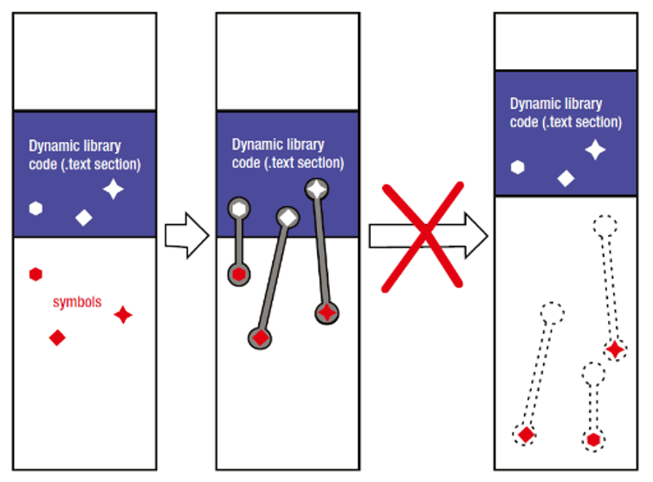
Load Time Relocation
// counter.h
struct Counter
{
…
static int& getCount()
{
static int counter = 0;
return counter;
}
};
What address we
should put here?

Slide 41
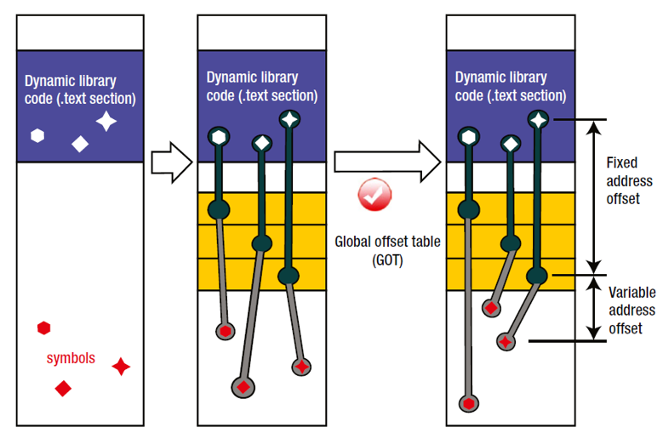
Position Independent Code

Slide 42
Static member mess up :: run on Linux
Compile and run it on Linux machine:
$ g++ -I./ -c -Wall -Werror -fPIC -o main_DLL.o main_DLL.cpp
$ g++ -shared -fPIC -o libsharedLib.so main_DLL.o
$ LD_LIBRARY_PATH = <path to sharedLib>
$ export LD_LIBRARY_PATH
$ g++ Wall -Werror –o simpleExample main.cpp -L./ -lsharedLib
$ ./simpleExample
main_DLL : ptr = 0x6013a0 value = 1
main_EXE : ptr = 0x6013a0 value = 2
// conclusion: the same counter addressed
Note: In Linux all symbols are exported from shared library.

Slide 43
Static member mess up :: run on Linux
$ nm -C -S libsharedLib.so
...
0000000000200f08 0000000000000004 V Counter::getCount()::counter
...
$ nm -C -S simpleExample
...
00000000006013a0 0000000000000004 V Counter::getCount()::counter
...
According to https://sourceware.org/binutils/docs/binutils/nm.html:
“When a weak undefined symbol is linked and the symbol is not defined, the value of the weak symbol becomes zero with no error.”

Slide 44
Static member mess up :: Windows version
In Windows you should export all symbols manually, so we should make following changes:
// main_DLL.cpp
...
extern "C"
{
__declspec(dllexport) void main_DLL()
{ ... }
}
// main.cpp
...
extern "C"
{
__declspec(dllimport) void main_DLL();
}

Slide 45
Static member mess up :: run on Windows
Compile and run it on Windows machine:
$ g++ -c -Wall -Werror -o main_DLL.o main_DLL.cpp
$ g++ -shared -Wl,--out-implib=libsharedLib.a -o libsharedLib.so main_DLL.o
$ g++ -Wall –Werror -o simpleExample main.cpp -L./ -lsharedLib
$ ./simpleExample.exe
main_DLL : ptr = 0x68783030 value = 1
main_EXE : ptr = 0x403080 value = 1
// conclusion: two different counters

Slide 46
Static member mess up :: run on Windows
$ nm -C -S libsharedLib.so
...
0000000068783030 0000000000000004 D Counter::getCount()::counter
...
$ nm -C -S simpleExample.exe
...
0000000000403080 0000000000000004 D Counter::getCount()::counter
...
According to https://sourceware.org/binutils/docs/binutils/nm.html:
“D” means “The symbol is in the initialized data section.”
Also you can confirm our hypothesis using disassembly listing (“objdump –d”).

Slide 47
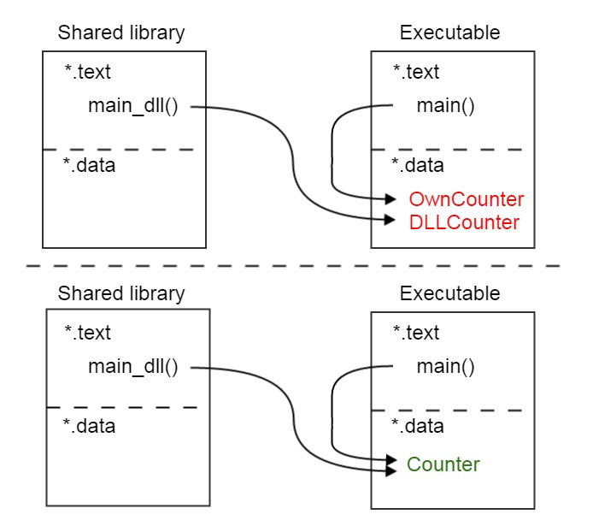
Static member mess up :: Windows version

Slide 48
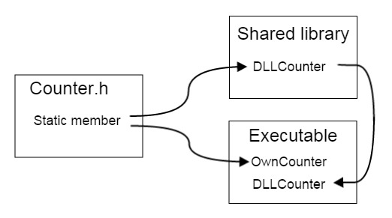
Static member mess up :: Windows version

Slide 49
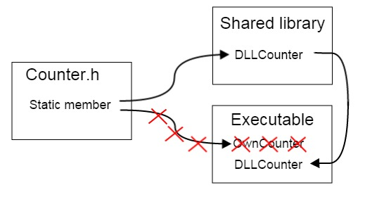
Static member mess up :: Windows version

Slide 50
Static member mess up :: Win :: same counters
To fix this issue on Windows we should do the following:
1. Split declaration and definition of Counter.
// counter.h
#pragma once
struct EXPORT_IMPORT Counter
{
Counter();
static int& getCount();
};
// counter.cpp
#define EXPORT_IMPORT __declspec(dllexport)
#include "counter.h"
Counter::Counter()
{
++getCount();
}
int& Counter::getCount()
{
static int counter = 0;
return counter;
}

Slide 51
Static member mess up :: Win :: same counters
To fix this issue on Windows we should do the following:
Split declaration and definition of Counter.
Export Counter from dll.
// main_DLL.cpp
#include <iostream>
#define EXPORT_IMPORT __declspec(dllexport)
#include "counter.h"
extern "C"
{
EXPORT_IMPORT void main_DLL()
{ ... }
}

Slide 52
Static member mess up :: Win :: same counters
To fix this issue on Windows we should do the following:
Split declaration and definition of Counter.
Export Counter from dll.
Import Counter in executable.
// main.cpp
#include <iostream>
#define EXPORT_IMPORT __declspec(dllimport)
#include "counter.h"
EXPORT_IMPORT void main_DLL();
...

Slide 53
Static member mess up :: Win :: same counters
Results:
$ g++ -c -Wall –o counter.o counter.cpp
$ g++ -c -Wall –o main_DLL.o main_DLL.cpp
$ g++ -shared -Wl,--out-implib=libsharedLib.a –o libsharedLib.so
main_DLL.o counter.o
$ g++ -o simpleExample main.cpp -L./obj/ -lsharedLib
$ simpleExample.exe
main_DLL : ptr = 0x68787020 value = 1
main_EXE : ptr = 0x68787020 value = 2
// conclusion: one counter addressed

Slide 54
Static member mess up :: Linux :: diff counters
To make two different counters on Linux you should hide the symbol using visibility attribute:
// counter.h
…
struct DLL_HIDE Counter
{
…
// main_DLL.cpp
#include <iostream>
#define DLL_HIDE __attribute__ ((visibility("hidden")))
#include "counter.h“
Note: Much more safer way to do it is to transform shared library into static.

Slide 55
Static member mess up :: Linux :: diff counters
Or you can make such a “hack”:
// main_DLL.cpp
#include <iostream>
#define Counter CounterDLL
#include "counter.h"
So, we force compiler to create different counters.
Result:
./simpleExample
main_DLL : ptr = 0x7f392ed87e64 value = 1
main_EXE : ptr = 0x6012bc value = 1

Slide 56
References
“Advanced C and C++ Compiling” Milan Stevanovic (http://www.amazon.com/Advanced-C-Compiling-Milan-Stevanovic/dp/1430266678).
Sources for all examples that we covered you can find under this link: https://github.com/dendibakh/Linker.
David Drysdale, Beginner's guide to linkers (http://www.lurklurk.org/linkers/linkers.html).
Alexander Bernauer‘s blog (http://blog.copton.net/articles/linker/).
http://stackoverflow.com/questions/31495877/i-receive-different-results-on-unix-and-win-when-use-static-members-with-static
GNU binary utils https://sourceware.org/binutils/docs/binutils.
Advanced: Linker scripts https://sourceware.org/binutils/docs/ld/Scripts.html.

Slide 57
Thank you!
“Diving into C++ linker”
Denis Bakhvalov
29-07-2015

Slide 58
Copyright and confidentiality
The contents of this document are proprietary and confidential property of Nokia Solutions and Networks. This document is provided subject to confidentiality obligations of the applicable agreement(s).
This document is intended for use of Nokia Solutions and Networks customers and collaborators only for the purpose for which this document is submitted by Nokia Solution and Networks. No part of this document may be reproduced or made available to the public or to any third party in any form or means without the prior written permission of Nokia Solutions and Networks. This document is to be used by properly trained professional personnel. Any use of the contents in this document is limited strictly to the use(s) specifically created in the applicable agreement(s) under which the document is submitted. The user of this document may voluntarily provide suggestions, comments or other feedback to Nokia Solutions and Networks in respect of the contents of this document ("Feedback"). Such Feedback may be used in Nokia Solutions and Networks products and related specifications or other documentation. Accordingly, if the user of this document gives Nokia Solutions and Networks Feedback on the contents of this document, Nokia Solutions and Networks may freely use, disclose, reproduce, license, distribute and otherwise commercialize the feedback in any Nokia Solutions and Networks product, technology, service, specification or
other documentation.
Nokia Solutions and Networks operates a policy of ongoing development. Nokia Solutions and Networks reserves the right to make changes and improvements to any of the products and/or services described in this document or withdraw this document at any time without prior notice.
The contents of this document are provided "as is". Except as required by applicable law, no warranties of any kind, either express or implied, including, but not limited to, the implied warranties of merchantability and fitness for a particular purpose, are made in relation to the accuracy, reliability or contents of this document. NOKIA SOLUTIONS AND NETWORKS SHALL NOT BE RESPONSIBLE IN ANY EVENT FOR ERRORS IN THIS DOCUMENT or for any loss of data or income or any special, incidental, consequential, indirect or direct damages howsoever caused, that might arise from the use of this document or any contents of this document.
This document and the product(s) it describes are protected by copyright according to the applicable laws.
Nokia is a registered trademark of Nokia Corporation. Other product and company names mentioned herein may be trademarks or trade names of their respective owners.
© Nokia Solutions and Networks 2014

